Slide 1

A-Level Accounting

Slide 2
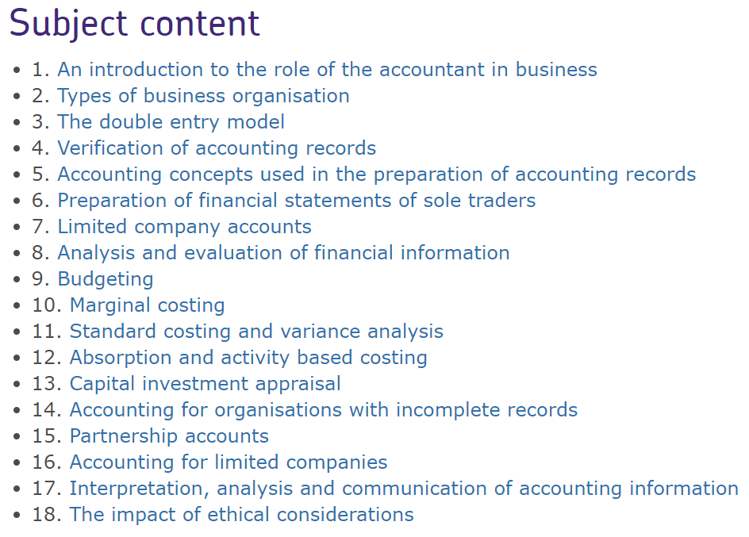
Accounting
A-Level Accounting
Exam Board: AQA
Course Code: 7127

Slide 3

Big Question:
How do ethical principles affect the behaviour of accounting professionals?

Slide 4
Ethical Principles
There are 5 fundamental ethical principles
1. Professional competence and due care
2. Professional behaviour
3. Confidentiality
4. Integrity
5.Objectivity
Watch the video to find out more about each principle
https://www.youtube.com/watch?v=LxQMTfdvNBI

Slide 5
Your task
For each ethical principle, create a scenario whereby an accountant may be in breach of that principle.

Slide 6
Show You Know
Answer these questions:
1) State the 5 ethical principles
2) Match the 5 ethical principles to the statements below
Posting inappropriate videos on Facebook after a night out
Sharing a clients accounts with your uncle because he is a competitor of the client
Completing a VAT return whilst the finance manager is on holiday. You have had no training apart from self made YouTube videos
Advising the company director that donations to political parties such as Labour are not allowed because you follow the Conservative party
Not disclosing some expenses to show a higher profit
3) If Accountants do not abide by the ethical principles, who may this impact?
4) How will you remember all 5 principles?

Slide 7

Join us on:
Twitter – tcolc_econbus

Slide 8
Contact
Head of Department: Mr Johal
Mjohal@cityleicester.leicester.sch.uk
Teacher of Accounting
hpatel@cityleicester.Leicester.sch.uk

