Slide 1
A-Level Economics

Slide 2


Big Question:
Make sure you click the audio icon when presented.

Slide 3
Economics
A-Level Economics A
Exam Board: Edexcel (Pearson)
Course Code: 9ECO
Introduction:
Teachers

Slide 4
So, what is Economics all about then?
Economics is a social science which tries to help with decision making.
It tries to help us to understand how we can make the most of the limited resources we have.

Slide 5
If you think about it:
Everyone wants a nice house, car, holidays and soon. But we can’t have them because we don’t have enough money
Businesses want to develop new ideas, they want to expand, and they want to advertise and so on. But they can’t because they have limited funds
The government wants to spend lots on education, health, foreign aid, pensions and so on. But it can’t because it has a limited income.

Slide 6
So, what is Economics all about then?
So, Economics is a study of how society deals with the fundamental problem of unlimited needs and wants, but limited resources. We call this the economic problem.

Slide 7
Your Task
I have a task for you.
You have to make some important decisions to make.
You will weigh up the options and then make a judgment.
You will have 20 minutes for the task.
Pause this video and complete the task.

Slide 8
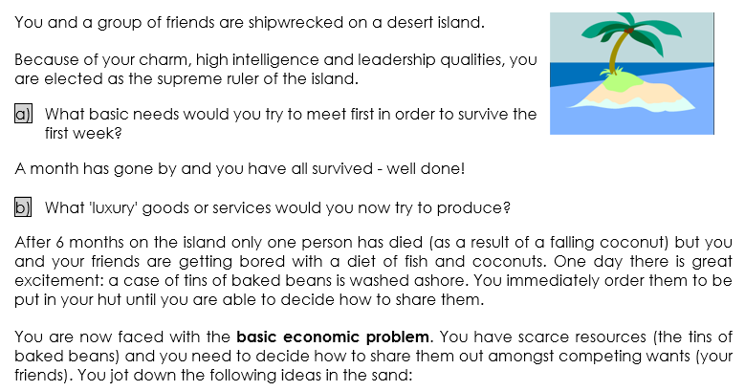
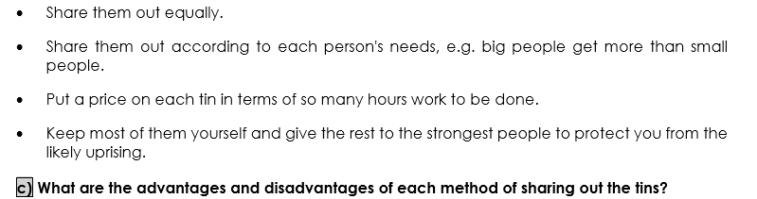
Q
Q
Q

Slide 9
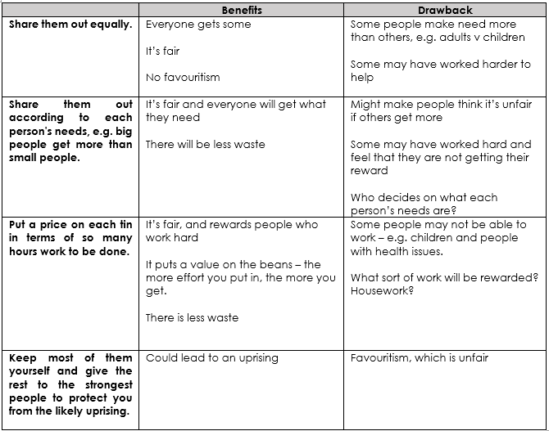

Slide 10
Why you completed this task.
Although this task was simple, it does has real world application.
Every country around the world will have to make a decision about how to allocate their resources.
There are unlimited wants but limited resources.

Slide 11
Types of Economies in Countries
We call countries which decides that everyone gets the same, planned or command economies. E.g. Cuba
We call countries which believe that allocation should be according to work done, free market or capitalist economies. E.g. USA
Countries have gone to war and millions have died as a result of countries believing that their system is the best.

Slide 12

Health Care UK v Health Care USA
Read this article to help you appreciate how the UK and USA try to solve the economic problem when it comes to providing health care.
https://www.healthcareadministration.com/brief-comparison-uk-healthcare-system-vs-u-s-healthcare-system/#:~:text=While%20both%20systems%20have%20world,tax%20based%20system%20versus%20the

Slide 13
Show You Know
Answer these questions:
What is economics?
What are some economic decisions which we have to make?
What are some ways in which resources may be distributed?

Slide 14
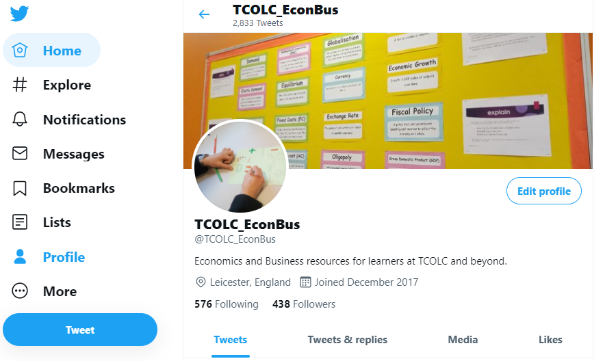
Join us on:
Twitter – tcolc_econbus
Head of Department: Mr Johal
Mjohal@cityleicester.leicester.sch.uk
Teacher of Economics: Mr Sattar
Asattar@cityleicester.leicester.sch.uk

