Slide 1
A Level Mathematics

Slide 2
What’s studying A Level Maths at TCOLC all about?

Slide 3
A Level Mathematics
THE COURSE
You will have a total of nine lessons each fortnight shared between two teachers. In Year 13 this increases to ten lessons a fortnight.
You will be studying for the Edexcel exam board.
No coursework – 100% examination.
There are three examinations at the end of the course (you can use a scientific calculator or graphics calculator in all three!)
At the end of Year 13 each exam is 2 hrs:
Pure Maths Exam Paper 1
Pure Maths Exam Paper 2
Mechanics and Statistics Exam Paper 3

Slide 4
A Level Mathematics
YEAR 11 TO YEAR 12 TRANSITION WORK
This summer we will provide you with some basic skills work to help with your transition to A Level.
Year 11 to 12 Maths Transition Booklet – this contains practise for all the basic skills you will require from day one of the course.
Extension Tasks – these will help you to develop your problem solving skills.

Slide 5
A Level Mathematics
A LEVEL TARGET GRADES
Target grades will be set using the average GCSE point score from all your GCSE subjects.
These are the most common target grades for our students:
Grade 6 in Maths at GCSE – Target Grade C
Grade 7/8 in Maths at GCSE – Target Grade B
Grade 8/9 in Maths at GCSE – Target Grade A

Slide 6
A Level Mathematics
EXPECTATIONS
You will be expected to keep your lesson notes, examples and homeworks/tests organised in a folder with dividers. You may use an exercise book for lesson notes if you prefer.
You will be set weekly homework by each teacher.
You will be expected to practise techniques learnt in class. As a rule of thumb, you should expect to do at least one hour of work out of class for every hour in class.
We will also be using the excellent online Integral learning platform, which lets you extend and reinforce your understanding through independent study. You will be given a username and password in September.
This year we have also used UpLearn and MyMaths.

Slide 7
A Level Mathematics
BASIC SKILLS TEST
The minimum requirement of a grade 6 in Maths at Higher Tier GCSE means that there are a number of essential basic skills that you will require from the very start of the course.

Slide 8
A Level Mathematics
BASIC SKILLS TEST
There will be a basic skills test within the first two weeks of the autumn term.
You are expected to use a calculator in the test.
The pass mark will be 85%.
You will have to resit if necessary.
There is practise for all the topics covered in the Year 11 to 12 Maths Transition Booklet

Slide 9
A Level Mathematics
BASIC SKILLS TEST
Topics to be tested:
Substitution (including negatives, fractions and BIDMAS)
Algebraic Expressions
Multiply/expand single and double brackets
Factorise single brackets
Factorise double brackets (with single x² or a prime multiple eg 3x²)
Simplify powers/indices

Slide 10
A Level Mathematics
BASIC SKILLS TEST
Topics to be tested:
Rearranging Formulae (where subject only appears once)
Equations (with x on both sides, brackets and fractions inc algebraic)
Inequalities
Graphs
Straight line graphs including y = mx + c
Quadratic graphs

Slide 11
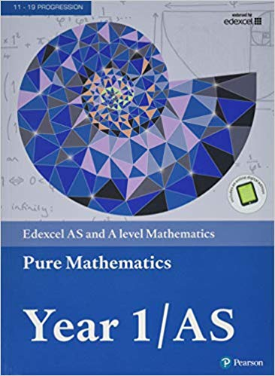
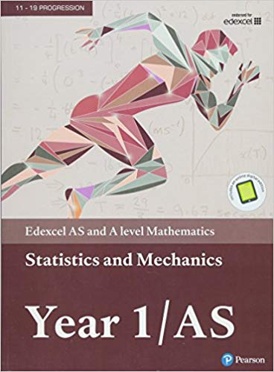
A Level Mathematics
BOOKS AND EQUIPMENT
The textbooks you require for Year 12 are published by Pearson Education.
Year 1/AS Pure (about £18)
ISBN:978-1292183398
Year 1/AS Stats and Mech (about £10)
ISBN:978-1292183398

Slide 12
ActiveLearn – online textbooks

Slide 13
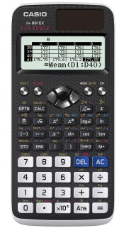
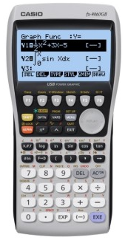
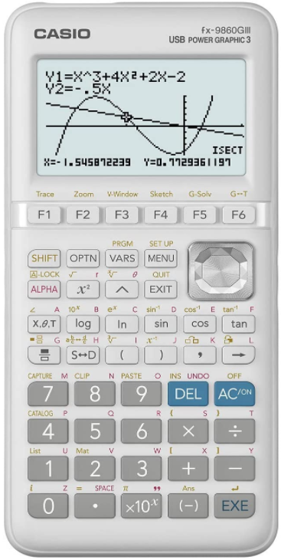
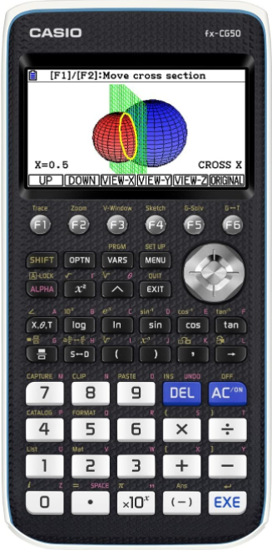
A Level Mathematics
BOOKS AND EQUIPMENT
A scientific calculator for the new specification is essential.
A graphical calculator can also be very useful!
Scientific
Casio fx-991EX Classwiz (around £20 from Amazon)
Graphical
Casio fx-9860II (around £80)
Graphical
Casio fx-9860III (around £80)
Graphical
Casio fx-CG50 (around £110)

Slide 14
Quick Quiz – A Level Maths@TCOLC
What exam board do we use for A Level Maths?
What’s the rule of thumb for how much independent study you should aim to complete?
What is scheduled during the first two weeks of the course?
Notes:
There are SEND students who are not high level needs, do not require intervention or additional support. (SEND- K) This is where we need to invest our time and make change if we are going to move our judgement from RI.
How are you going to meet that child's needs. What training, additional knowledge might you need?
What action do you need to take before Tuesday. E.g read through information provided, speak to form tutor, teacher who taught them previously, create some more resources, re-visit your lesson plans. Post it note- Share with HOD.

Slide 15
Quick Quiz – A Level Maths@TCOLC
What exam board do we use for A Level Maths at TCOLC? Edexcel
What’s the rule of thumb for how much independent study you should aim to complete? 1 hour out of class for every 1 hour in class!
What is scheduled during the first two weeks of the course? Basic Skills Test
Notes:
There are SEND students who are not high level needs, do not require intervention or additional support. (SEND- K) This is where we need to invest our time and make change if we are going to move our judgement from RI.
How are you going to meet that child's needs. What training, additional knowledge might you need?
What action do you need to take before Tuesday. E.g read through information provided, speak to form tutor, teacher who taught them previously, create some more resources, re-visit your lesson plans. Post it note- Share with HOD.

Slide 16
Further Questions
ylarge@cityleicester.leicester.sch.uk
nislam1@cityleicester.leicester.sch.uk

