Slide 1


A college wide support programme for High Achieving
students in Years 7 to 13
At the City of Leicester College we pride ourselves in the support we provide to a wide range of students across all year groups.
The Accelerate Your Ambition programme exists to provide tailored support for High Achieving Students.
If you are currently at TCOLC and joining us for the Sixth Form you are familiar with this programme from Year 11 and depending
on your GCSE results many of you will continue to receive this additional support in Years 12 and 13. If you are joining us from
September with GCSE Grades 7/8 and 9 across your subjects you will be part of this programme too.
In the Sixth Form the Accelerate Your Ambition Programme merges into the Elephant Access Programme
run by the Elephant Access Group. This is a charitable organisation that was set up to support students
in maintained secondary schools to get into top universities and studying courses such as Medicine or
Dentistry.
Please see separate leaflet for more information about the Elephant Group and the work they do.
Please see next slide for overview of how the Elephant Access Programme works in Years 12 and 13.

Slide 2
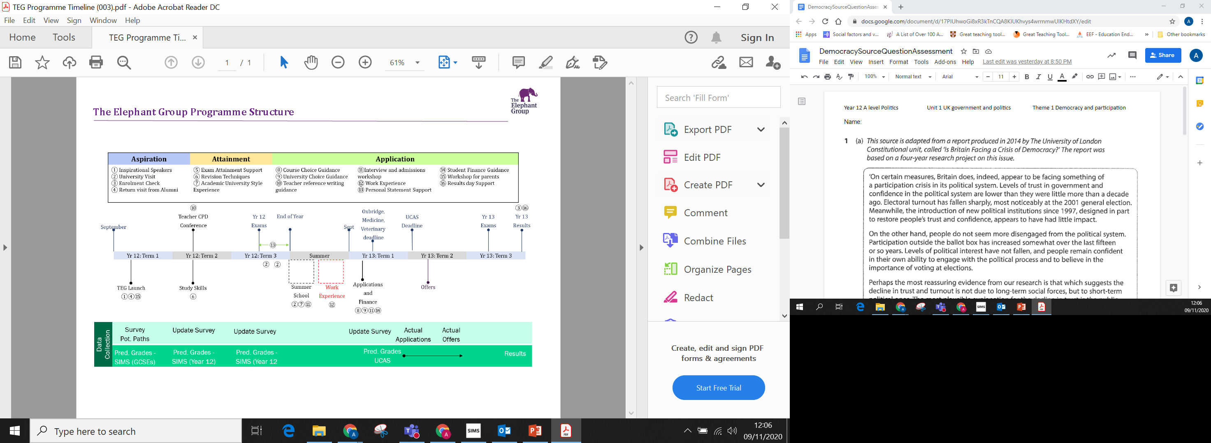
Below is the outline of how the Elephant Access support programme is delivered across Years 12 and 13.
Please note that in addition to the above the college has this year paid for all Elephant Group students studying Maths,
Chemistry and Economics to have access to Up Learn – a high quality online tutoring platform. It is hoped that we will continue
to provide this to all Year 12 students in the Elephant Access Group staring in September with a possibility of adding more
subjects. For more information please check out https://wp.uplearn.co.uk/

