Slide 1

TCOLC Sixth Form
Yr11 – 12 Taster day
Subject: BTEC Art & Design Extended Certificate
COLLEGE

Slide 2






Do Now…
List all the skills and personal qualities you think you will need to complete the BTEC Art and Design Extended Certificate.
You may have listed things such as:
Good time management
Planning and organising
Independent thinking
Team work
Creativity
Positive thinking
Problem solving
Good verbal communication skills
Good written literacy skills
Pride in your own work
Resilience
There are many many more……
The Big Question: How can I succeed in my studies for BTEC Art and Design Extended Certificate?

Slide 3
BTEC Level 3 National Extended Certificate in Art and Design
Who is this qualification for?
The Pearson BTEC Level 3 National Extended Certificate in Art and Design is an Applied General qualification. It is equivalent in size to one A Level and has been designed to occupy one third of the curriculum in a broader programme of study, which could include other vocational or academic qualifications.
What does this qualification cover?
The content of the qualification relates directly to the skills and understanding needed for further study in art and design and has been developed in consultation with Higher Education. The Pearson BTEC Level 3 National Extended Certificate in Art and Design is delivered through practical projects in art and design. There are three mandatory units which explore processes, methods of visually recording, creative intention and learners’ understanding and analysis of the work of artists and designers.
Learners develop skills and knowledge through an optional unit in a specific of 3D craft materials. The qualification is designed to enable learners to develop their knowledge and skills in the sector and increase their levels of independence.
The Big Question: How can I succeed in my studies for BTEC Art and Design Extended Certificate?

Slide 4

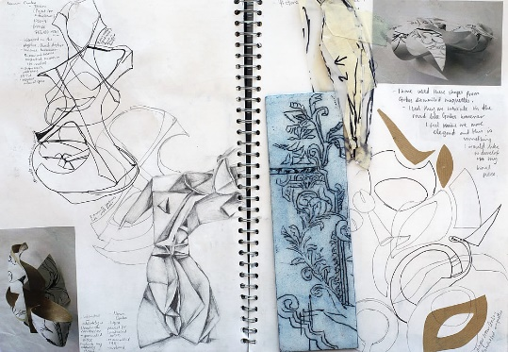

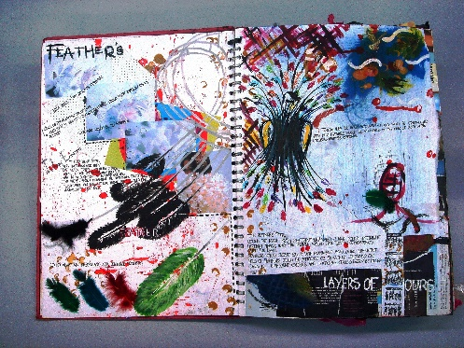

Externally Assessed Units
Unit 1: 120 GLH
Visual Recording and Communication
In this unit, you will develop your visual recording and communication skills through exploration and experimentation with materials and methods, gaining confidence in your ability to create work and express and communicate ideas. You will extend your skills through exploring the work of others, ongoing personal reflection and the refinement.
• A task set and marked by Pearson and taken under supervised conditions.
• Learners will be given a theme and a task in order to prepare a response before a supervised assessment period
Unit 2: 120 GLH
Critical and Contextual Studies in Art and Design
A task set and marked by Pearson and taken under supervised conditions.
• Learners are provided with a brief (Part A) four weeks before a supervised assessment period in order to carry out research.
• Learners will be provided with monitored research sessions of three hours scheduled by the centre to produce materials that can be used in the Part B supervised assessment.
• The supervised assessment period (Part B) is undertaken in a single session of three and a half hours
The Big Question: How can I succeed in my studies for BTEC Art and Design Extended Certificate?

Slide 5
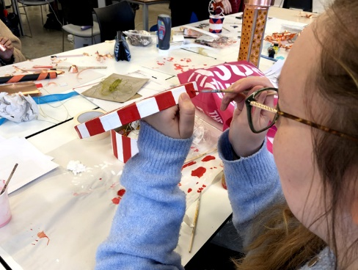
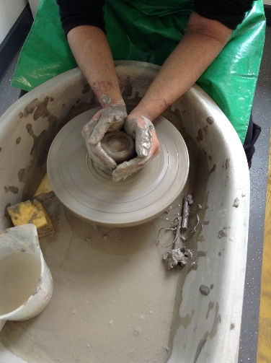
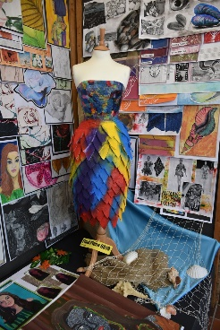
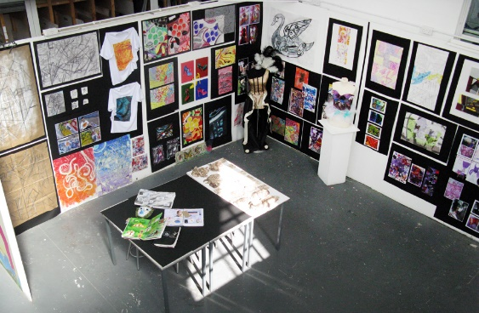
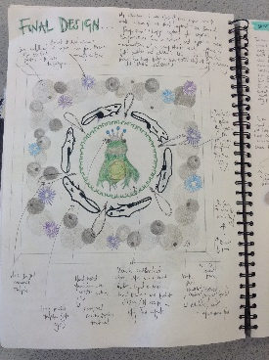
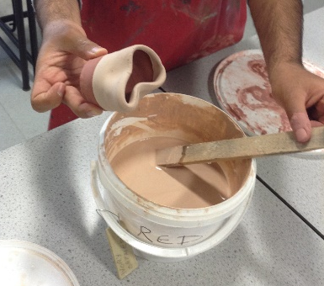
Internally Assessed Units
Unit 3: 60 GLH
The Creative Process
The mandatory synoptic assessment requires learners to apply learning from across the qualification to the completion of a defined vocational task. Within the assessment for Unit 3:
In this unit, you will explore the activities within the creative process. You will experiment with ideas generation techniques and contextual research activities. You will develop ideas through use of materials, techniques and processes, refining your ideas and reviewing your working practices. You will explore ways to present your work and understand the importance of self-reflection and evaluation as an ongoing process. You will also explore how these activities can relate and support each other, looking at alternative and innovative approaches. You will then apply your own creative process to a piece of art and design work, reflecting on what you have learned to help inform your future practice. In this unit you will draw on your learning from across your programme to complete assessment tasks.
Unit 16: 60 GLH
3D Design craft materials, techniques and processes
In this unit, you will find out about the skills required to produce contemporary design craft.
You will explore and experiment with different materials and techniques using resistant and non-resistant materials and focus on a good standard of finish. You will keep records and learn how to analyse your results. You will apply these skills when responding to a design craft brief to produce a finished item, reviewing and reflecting on the processes used and the finished product produced.
The Big Question: How can I succeed in my studies for BTEC Art and Design Extended Certificate?

Slide 6
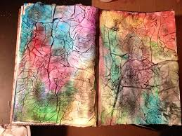
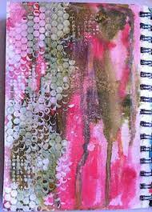
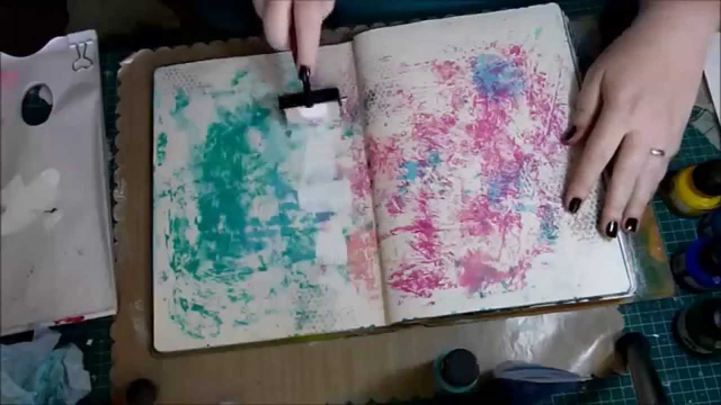

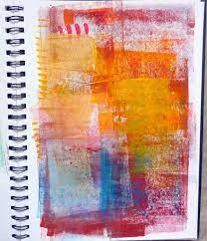

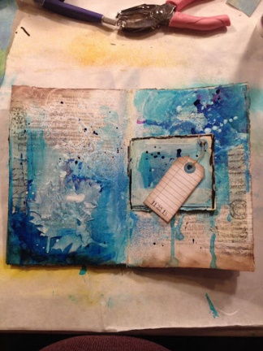
Task: Experiment with mark making techniques that could be used for a background on a sketchbook page. Try using items you have not used before- sponge, toothbrush, twigs, teabags. Be experimental and creative.
What? Experiment with different media to create interesting sketchbook pages. Why? Your sketchbook should be creative and unique to you. The background can help create a mood or feeling about the work on the page How? Experiment with different objects and media to try out a range of ideas. Be open to ideas and try out new techniques. There is not right or wrong.
Keywords: Experiment- testing out ideas Media- paint (acrylic, watercolour) pencils, chalks, charcoal etc Background- The page that your work is displayed on
TIF – Take it further challenge:
Try to combine different materials and tools.
Try to draw on paper you would not normally use; newspaper, baking paper, cardboard box
https://www.youtube.com/watch?v=t-yAnhdHBYs
The Big Question: How can I succeed in my studies for BTEC Art and Design Extended Certificate?
Notes:
Discussion on what textiles is, teacher could create list or bubble map, watch video discuss to see it students ideas have changed.

Slide 7

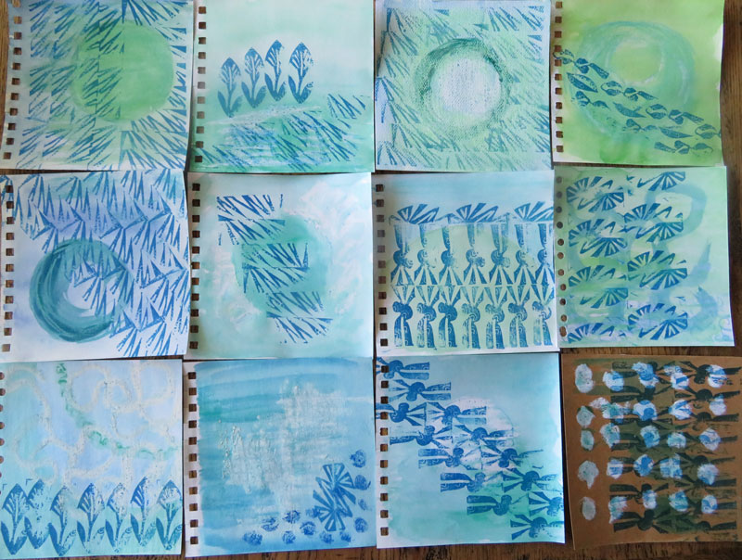
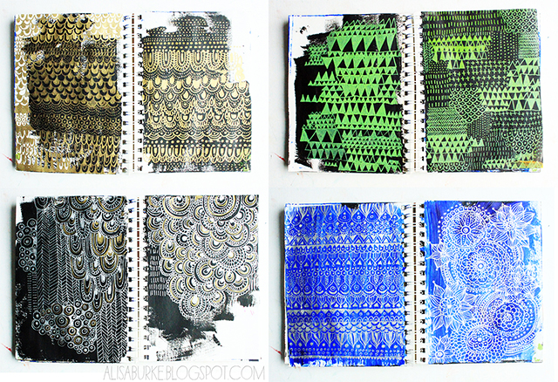
You should have 6-8 different style background that could be used in your sketchbook.
These will be useful when you complete your transition task.
The Big Question: How can I succeed in my studies for BTEC Art and Design Extended Certificate?

