Slide 1
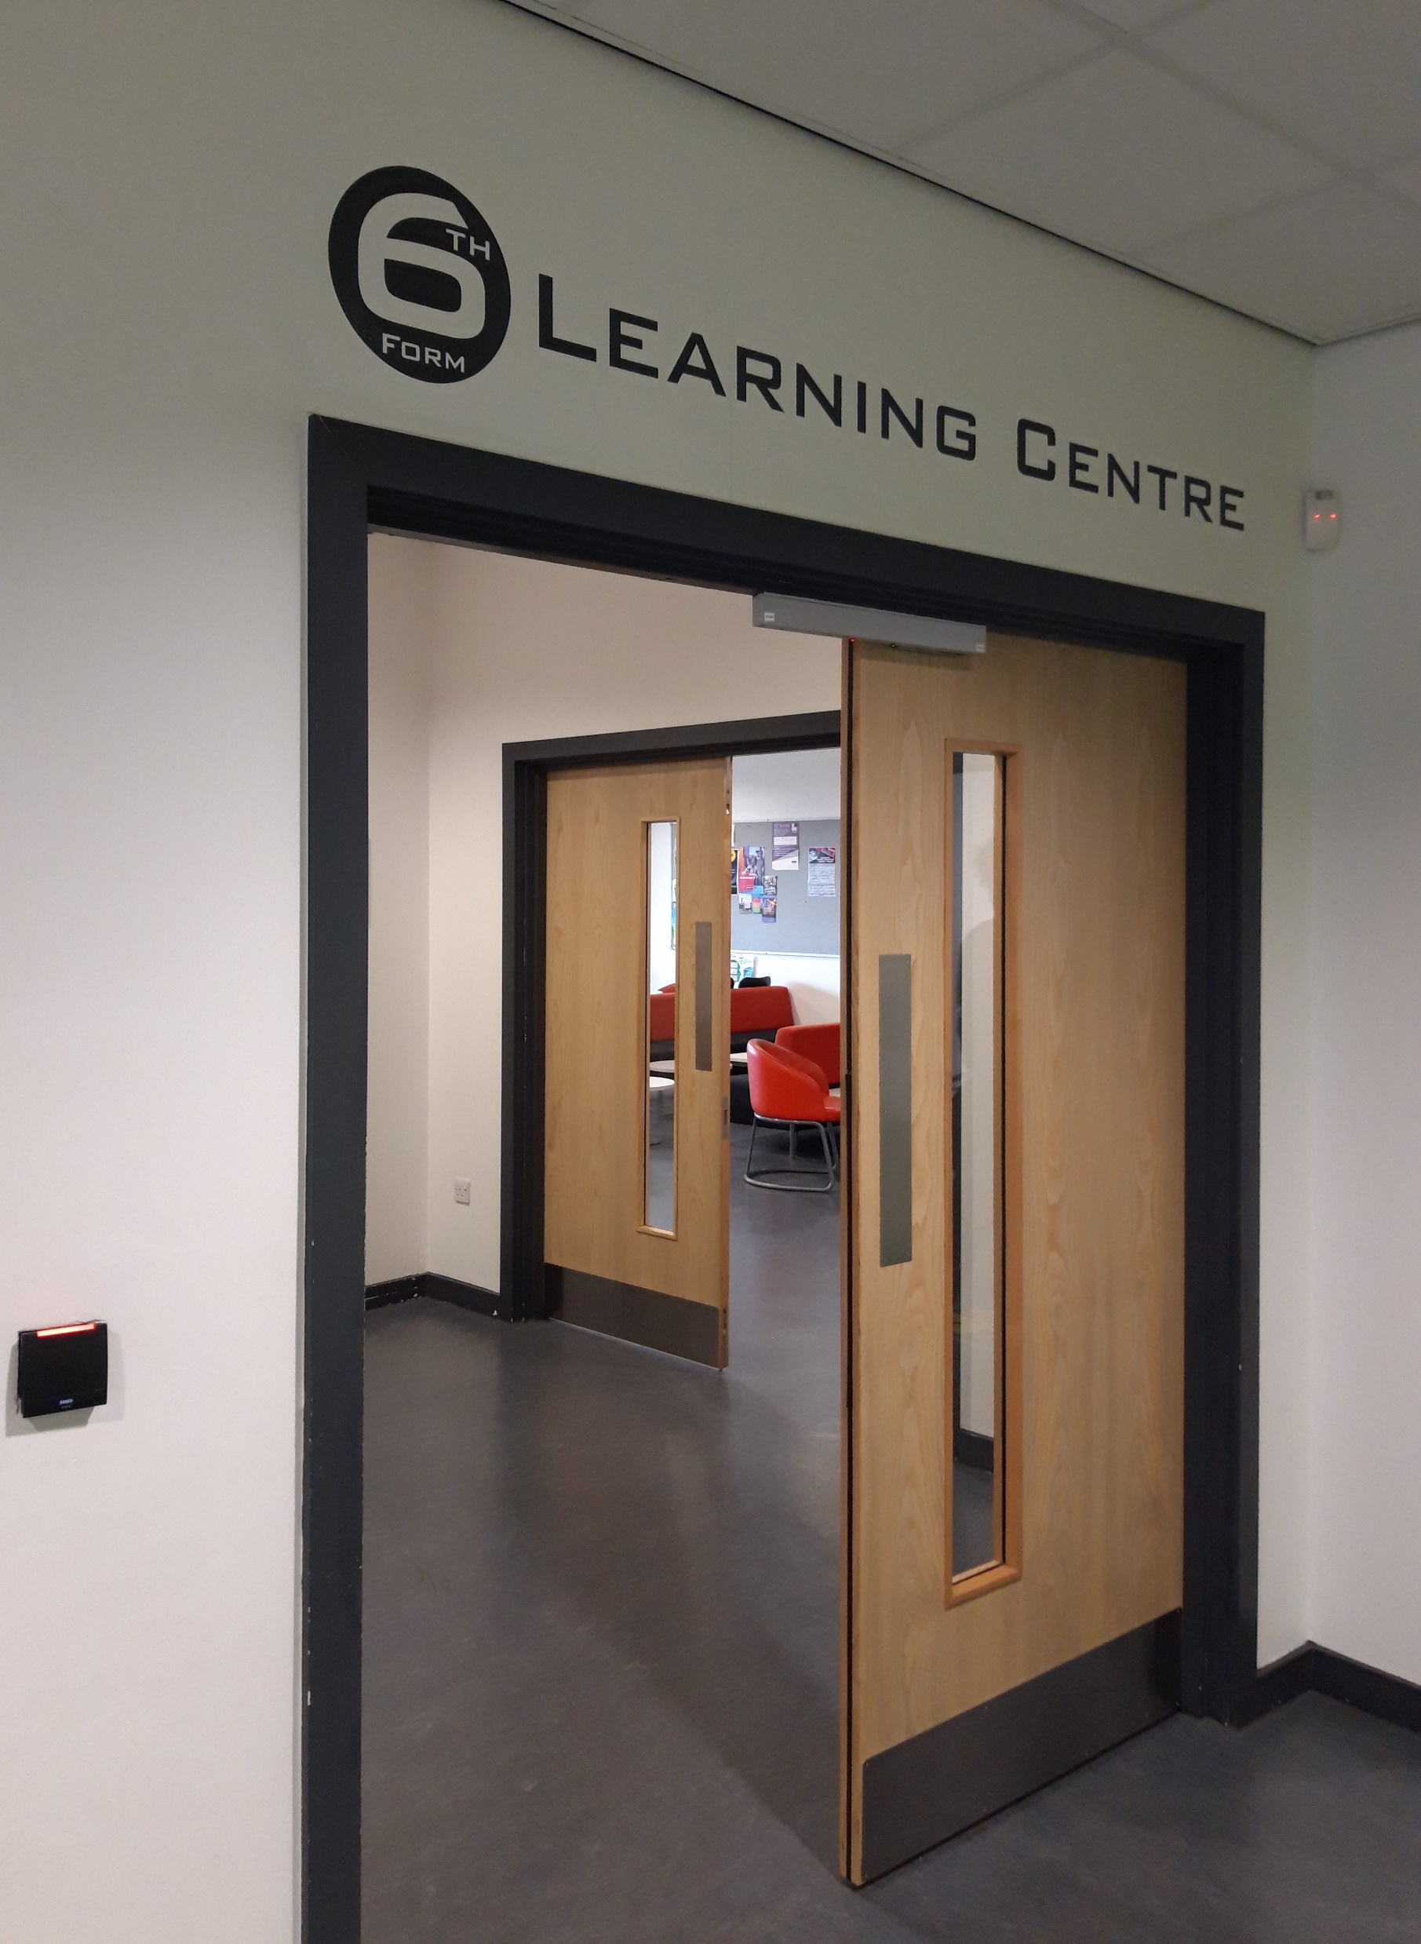
Study centre and Zone
Being a 6th form student with us means that you have your very own area to study and also have a place to relax with your friends at break times.

Slide 2
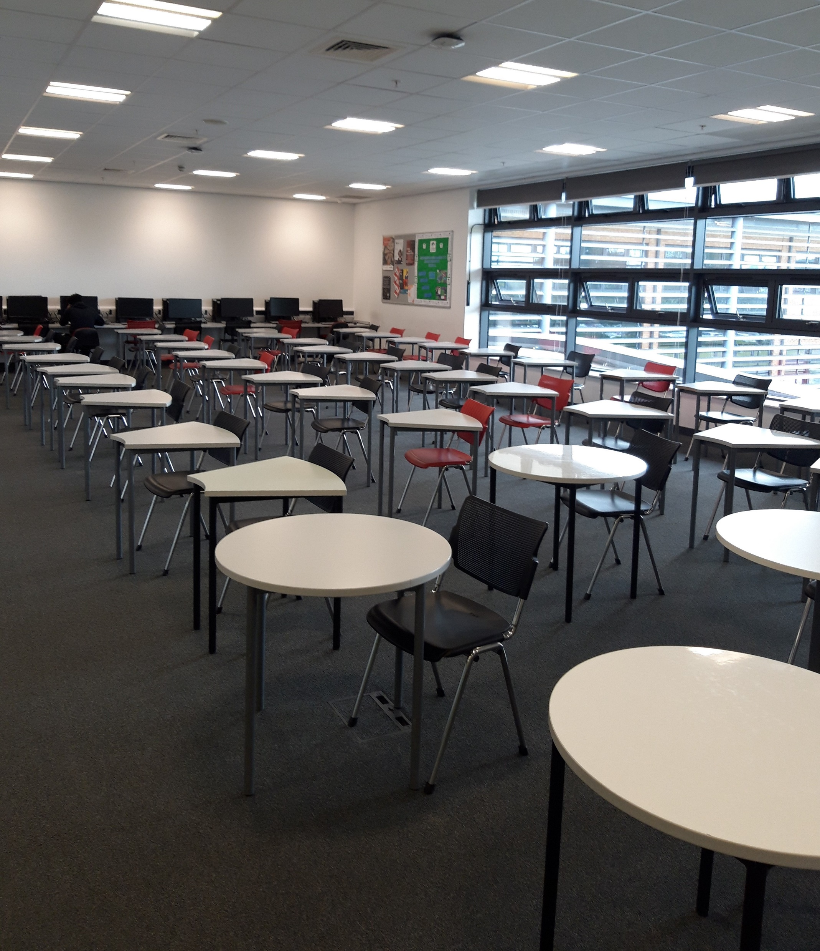
Study centre
The study centre is a quiet room, you will not have lessons all the time and this is where you have your independent study. You can also use one of the college computers.

Slide 3
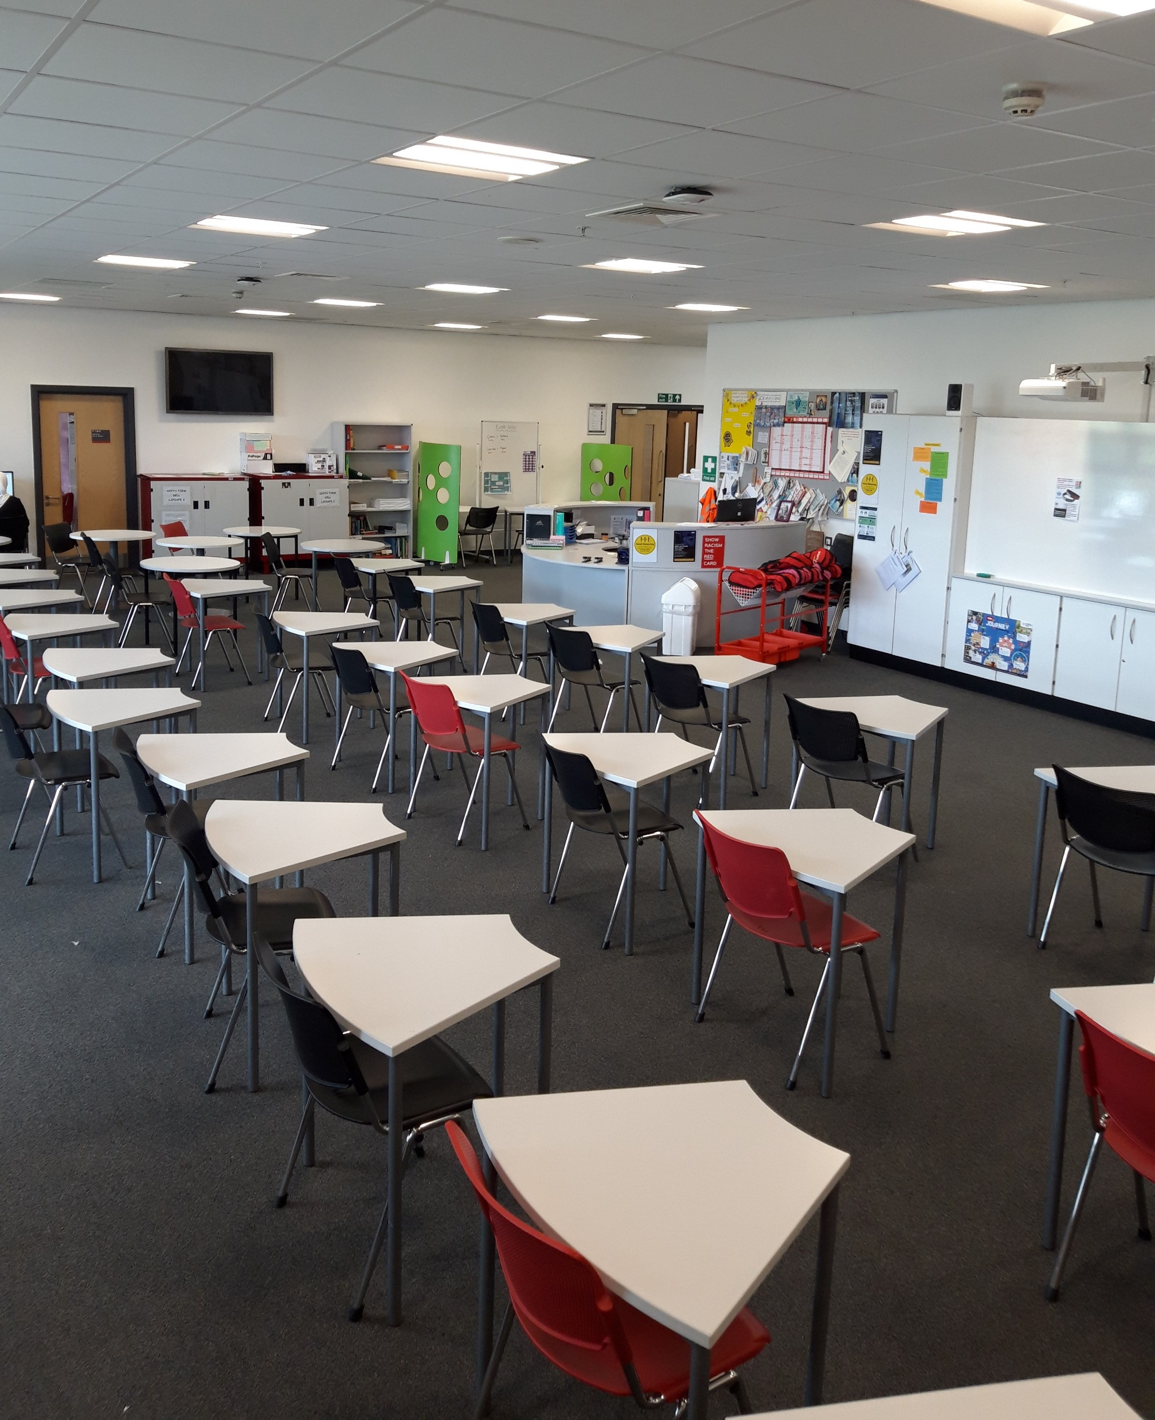
The study centre is also the room where I am based. I am here to support you with your independent learning and help you with any questions or queries.

Slide 4
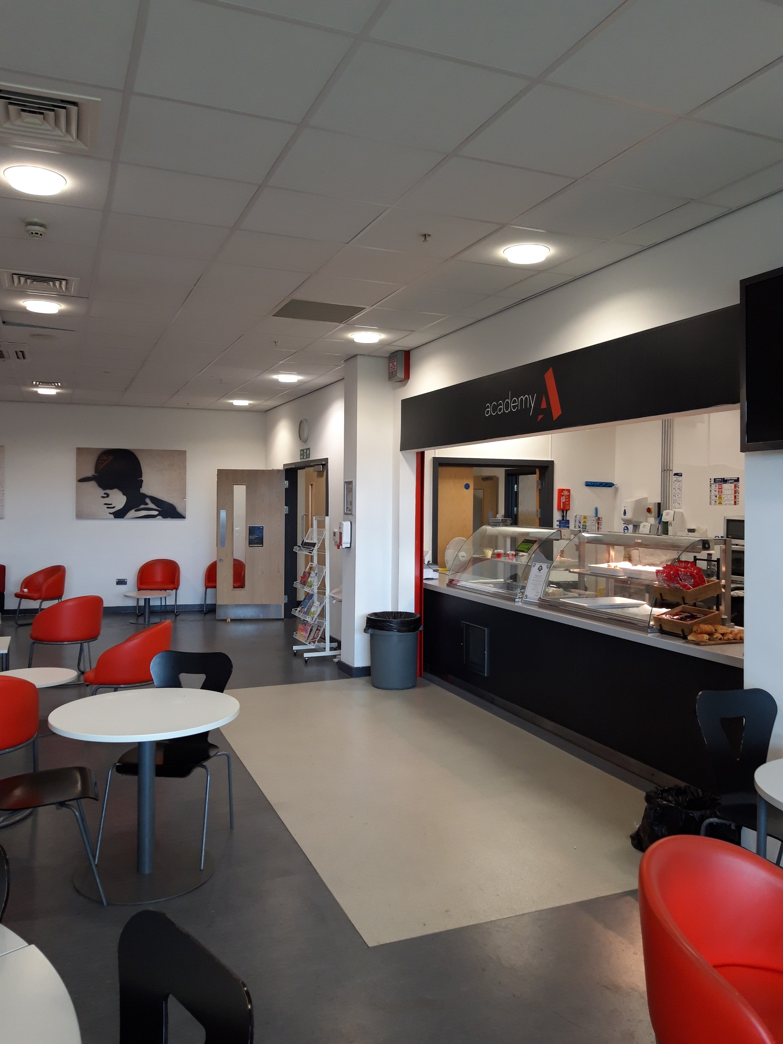
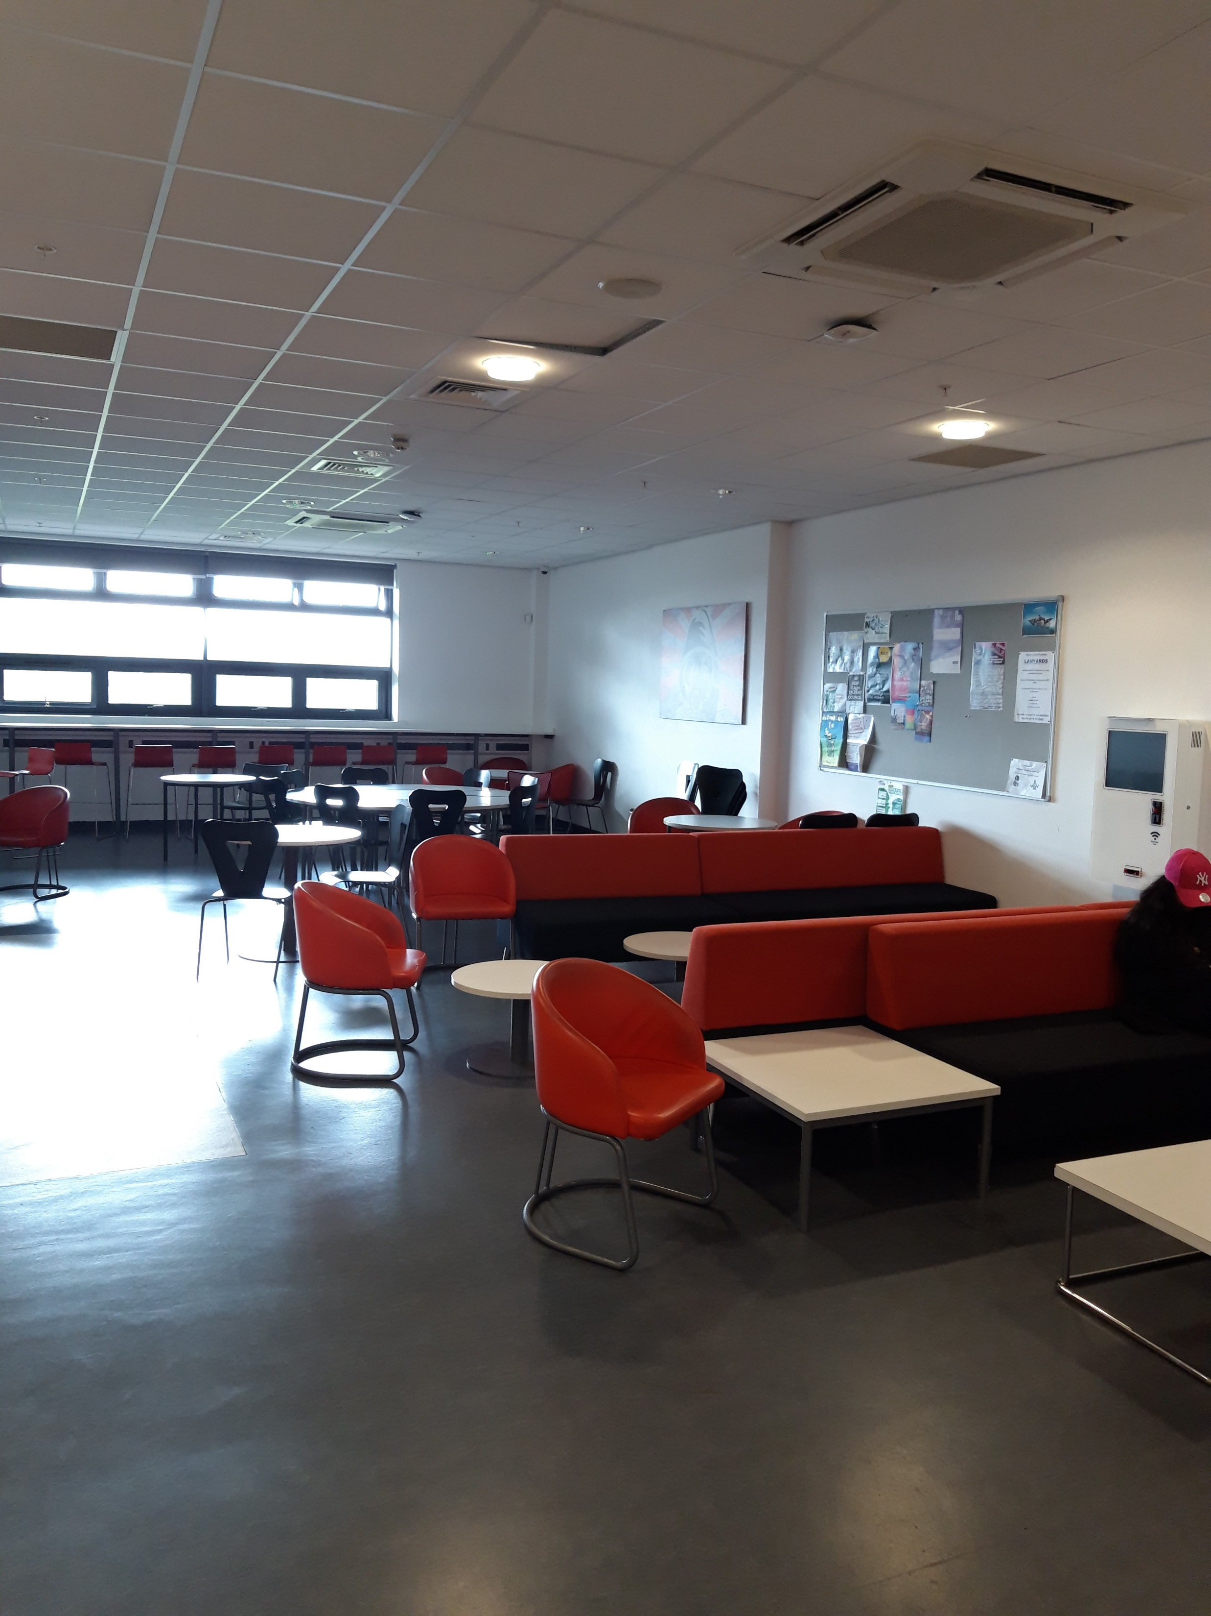
Zone
The Zone is the canteen area of the 6th form. You can buy food here and also catch up with your friends during break and lunch times.

