Slide 1
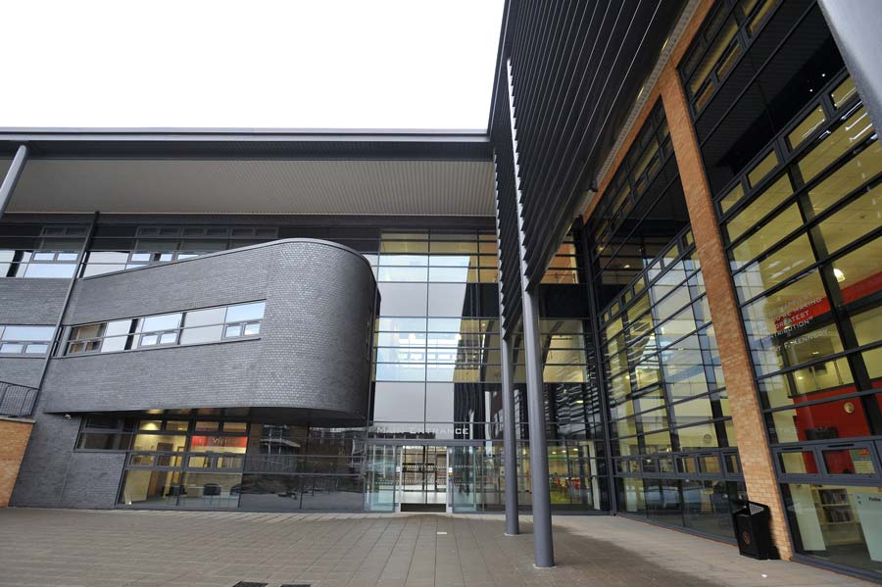
The City of Leicester College
Welcome

Slide 2
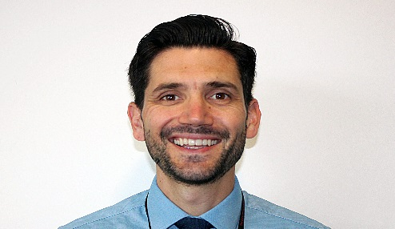
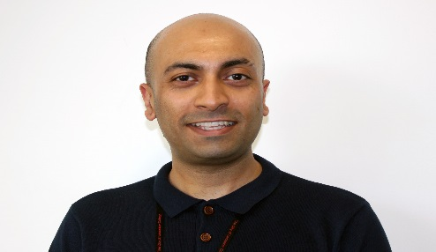
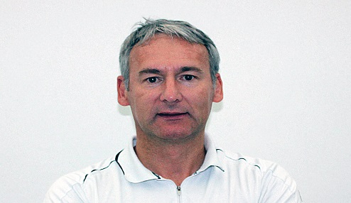
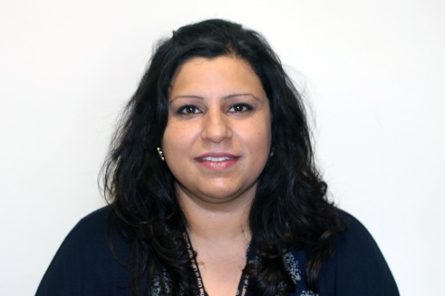
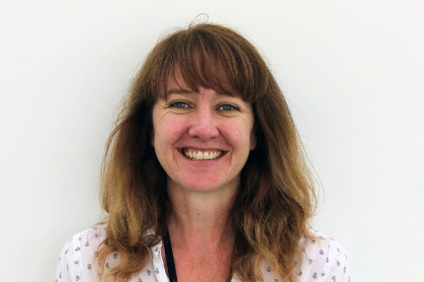
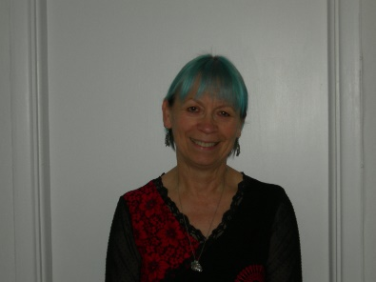
Meet the Team
Mr C. Dakin
Assistant Head i/c KS5
Mr D. Bhatt
Year 12 Achievement Coordinator
Mr A. Cruickshank
Year 13 Achievement Coordinator
Miss S. Soor
Sixth Form Mentor
Miss H. Hall
Study Centre Administrator
Miss D. Golby
Sixth Form Administrator

Slide 3
What can you expect?
Quotes from OFSTED about your Sixth Form:
Teaching in the sixth form is consistently of a high quality. Teachers match their teaching well to the prior attainment and current progress of students
Students respond well to the high-quality feedback they receive that enables them to improve their work.
Sixth-form students achieve well and make strong progress

Slide 4
Facts about your Sixth Form
TCOLC Sixth Form is rated “Good” by OFSTED 2019
Has a positive progress score for academic courses
Has a progress score for A levels that is in the top 25% across the nation
The number of our students who are in higher education one year after leaving college above the NATIONAL average.
94% of our students are in either education, employment or training one year after leaving TCOLC

Slide 5
A Supportive Atmosphere
Our pastoral support and guidance is excellent and is an essential element to your success in the Sixth Form.
We provide regular contact with experienced tutors who are able to guide and advise in a friendly, supportive manner.
We also have a careers advisor and specialist mentors as part of our team.
Trips & Events

Slide 6
Student Voice

Slide 8
Academic Curriculum
High quality teaching in a wide range of L3 subjects
A Level & Vocational options
Timetabled Independent Study
3 core courses
Core Maths
Extended project
3 progress points per year
Mock Exams

Slide 9
Pastoral Curriculum
Weekly assemblies
Dedicated pastoral time with your Tutor
Enrichment courses
Work Experience
Character Education

