Slide 1

Vocational ICT

Slide 2

The City of Leicester College – CS & ICT Department
Key Staff:
Mr N Jamal (NAJ) njamal@cityleicester.Leicester.sch.uk
Mr D Bhatt (DIB) dbhatt@cityleicester.Leicester.sch.uk
MR A Lambat (ASL) alambat@cityleicester.Leicester.sch.uk
Mr S Patel (SSP) spatel@cityleicester.Leicester.sch.uk
Location:
Purple Hub: Rooms - G30, G34, F34, F37

Slide 3
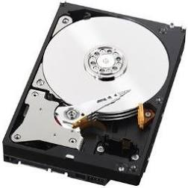
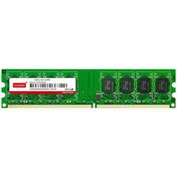
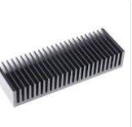
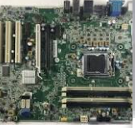
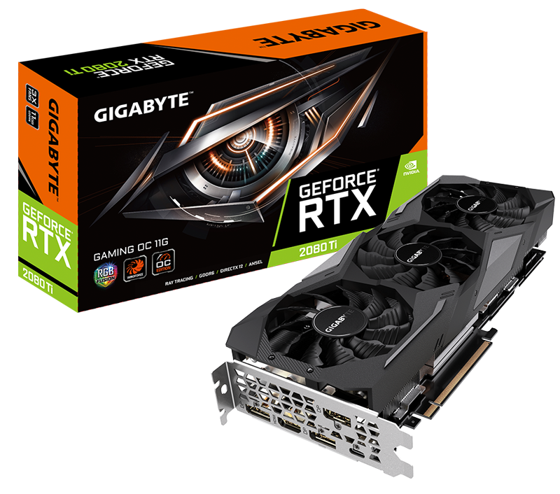
Do Now
State the name of each component below

Slide 4
Big Question
Have computers changed the way we live? If so, how?

Slide 5
Course Overview: Cambridge Technical ICT
2 year course
Options: study single ICT (1 A level) or double (2 A levels)
You will sit two exams and a series of coursework depending on which course you decide to study.
This course allows you to develop the skills needed in the world of work.
You will cover units related animations, web development, databases and a series of theory units.
Course is graded Pass, Merit, Distinction and Distinction *
We have a big uptake and majority of students achieve good grades in the subject.
You will complete a related work placement for 1 week in year 12

Slide 6
Course Overview:
Cambridge Technical ICT
Units you are likely to cover: (Full Range – visit the OCR website)
1. Fundamentals of ICT
2. Global Information
3. Computer Networks
4. Project Management
5. Product Development
6. Internet of Everything
7. Social Media and Digital Marketing

Slide 7
Task 1: Research
You are required to research into each component (Listed below):
Motherboard, Hard Drive, RAM, Sound Card, Heat Sink, Fan, DVD/CD Drive, Graphics Card, NIC (Network Interface Card), CPU
You will be required to complete this write up on a PowerPoint.
One slide for each component.
Find an image of the component
Explain what the component is used for

Slide 8
Task 2:
For this task, you must explain the importance of having each component.
Why is it important?
What would happen if this component was removed?
Add this new information to your slides.

Slide 9
Show you know
Can you identify the different components that make up a computer?
What are the most important components?

