Slide 1

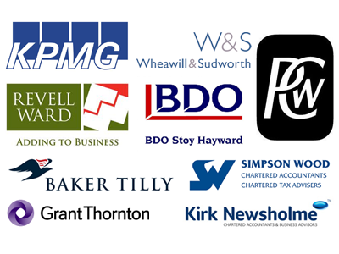


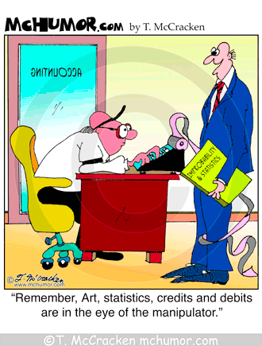
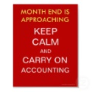
Accounting
A - Level AQA
General Course Information
A qualification in accounting will always be helpful – whether it's used professionally or personally. This course helps students to understand the responsibilities of the accountant and the impacts of their recommendations on the business and the wider environment.
Students will build knowledge and understanding of key concepts, principles and techniques that they can apply to real-life scenarios, developing the ability to solve problems logically, analyse data methodically, make reasoned choices and communicate effectively.
A logical approach to problem solving and an interest in business is important but many enterprising and key skills will be developed that are crucial to life in the 21st century.
The qualification has two key areas of study:
Financial accounting & Management accounting
How is the course assessed?
The course is very much based around students being given the relevant information and then completing questions to test and apply their knowledge in an accounting situation. This still lends itself to a number of different teaching styles and approaches however the course is very student centred.
Who’s it for?
The course is not part of the professional exams to qualify you as an accountant, these can be taken after you’re A Levels. The A Level will give you a sound foundation in the subject and this will make progression to become a professional accountant easier. You will need to have an interest in this particular area. You should also have some interest in the business and finance world in general.
Student will need to demonstrate quantitative skills that are relevant to the subject. Students will be expected to demonstrate knowledge of the formulae used for computations, carrying out computations and use the results of computations to inform judgements, solve problems and make decisions. Students must focus on developing their ability to write effectively so that they can report to stakeholders, making logical arguments and providing sound judgements based on analysis of available evidence taking account of financial and non-financial factors.
The minimum requirement is Mathematics grade 6, English grade 5.
Progression
This would obviously be a useful qualification for anyone thinking of doing accounting at university or as a job. It would also however be very useful in many business, commerce and financial areas. Accounting is a sign of a student's ability to understand difficult ideas and develop a capacity for methodological and critical thought, and is therefore useful in many different and varied areas.

