Slide 1
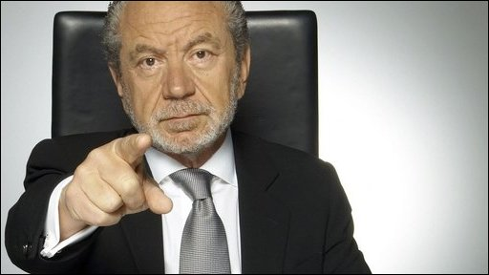
Business
A - Level Edexcel
General Course Information
The aim of the course is to enable students to develop an interest in and enthusiasm for Business. It will engage student and help them understand and appreciate the world of business.
Where ever students go they will be stepping into a business, whether this is coming to school, going shopping or visiting the cinema with their friends. Businesses are everywhere. Therefore this course will help students appreciate how a business works and all the elements that come together to make a business successful. A-Level Business will help students in the future as they are likely to work in one or even be in charge of their own business one day.
This exciting course has four main themes over the two years. Students will build up their core knowledge of business concepts and apply them to business contexts and real businesses. They will then consider more complex business issues and take a strategic view of business opportunities and issues.
A-level content
Marketing and People
Managing Business Activities
Business Decisions and Strategies
Global Business
Assessment
Three 120 minute exam papers
There are three externally assessed papers at A-Level. Each paper comprises 100 marks and is two hours in duration. Questions range from short answer questions, data response and extended open response. Paper 3 is based on some pre-released materials.
Who’s it for?
Everyone will one day run or work in a business of some kind, so Business will always have some relevance to your future. You should, however, also have some genuine interest in the subject and a commitment to hard work. There is a large amount of factual knowledge that you will have to learn but you will also need to be able to apply ideas to the real world and to case studies, be prepared to use the media, and realise that there is often more than one approach to a problem, as well as many possible solutions.
The minimum requirement is English grade 5 and Mathematics grade 4. Previous knowledge of the subject is not needed but if it has been studied a minimum of a grade 4 is required.
Progression
The eclectic nature of A-Level Business gives students an excellent grounding for University and those seeking internships or employment. Business and related degree courses continue to be the biggest single subject area within Higher Education.
A-Level Business is a good basis for progression to degrees in Business Administration, Marketing, Human Resources, Accountancy, Stock broking, Finance and Banking. There are numerous Business degrees and most universities provide business courses. Many courses are connected with a particular area of business such as: Business with Computing, Business & Management, International Business, Business with a Language, or Business and Finance.

