Slide 1
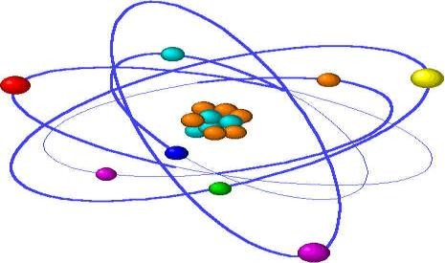
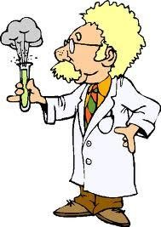
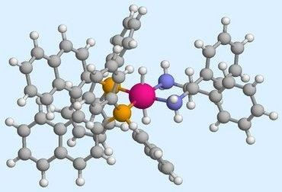
Chemistry
A - Level AQA
General Course Information
A-level Chemistry attempts to answer the big question ‘what is the world made of’ and it’s the search for this answer that makes this subject so fascinating. From investigating how one substance can be changed drastically into another, to researching a new wonder drug to save millions of lives, the opportunities that chemistry provides are endless.
How is the course assessed?
We follow the AQA Chemistry (7405) syllabus: details can be found on the AQA website www.aqa.org.uk.
The content is divided into three fundamental chemistry areas:
Physical chemistry (Including atomic structure, amount of substance, bonding, energetics, kinetics, chemical equilibria and Le Chatelier’s principle, thermodynamics, rate equations, the equilibrium constant Kp, electrode potentials and electrochemical cells
Inorganic chemistry Including periodicity, Group 2 the alkaline earth metals, Group 7(17) the halogens, properties of Period 3 elements and their oxides, transition metals and reactions of ions in aqueous solution
Organic chemistry Including introduction to organic chemistry, alkanes, halogenoalkanes, alkenes, alcohols, organic analysis, optical isomerism, aldehydes and ketones, carboxylic acids and derivatives, aromatic chemistry, amines, polymers, amino acids, proteins and DNA, organic synthesis, NMR spectroscopy and chromatography
The full A-level qualification has three terminal examinations which will cover the content of the whole two-year course and assess the twelve required practical’s. In order to progress to A-level Chemistry, you must achieve a grade 6-6 or higher in GCSE Combined Science: Trilogy (Double).
Practical assessment will be covered by maintaining a lab book of twelve required experimental tasks. A complete lab book is a requirement of passing the practical skills assessment. The theory of practical skills and data analysis is assessed within the examinations.
Who’s it for?
What do I need to start a Chemistry A-level course?
Enthusiasm!
At least 5 GCSE’s grade 4 or higher, including English Language at Grade 5 and Mathematics at Grade 6.
Grade 6-6 or higher in GCSE Combined Science: Trilogy (Double)
Grade 6 in Chemistry GCSE and 6-6 in the other two sciences
There is overlap between Chemistry and the other sciences, especially Biology. There are also obvious links with Mathematics, and it is strongly advised students take this course or level 3 core maths. However, we will be happy for students to take Chemistry out of pure interest, yet this could limit progress in some areas of the course.
Chemistry is a practical subject as well as a rigorous academic discipline. You must be prepared for this aspect of the course and should enjoy practical work, such as qualitative analysis and titrations.
Progression
Chemistry is a very useful, well respected A-Level. It is recognized as being an A-Level which develops a wide range of skills. The subject is good preparation for study of Chemistry related courses at University and can lead onto a career in the Chemistry industry.
Biological sciences are becoming ever increasingly biochemical and Chemistry AS and A-Level will be vital to anyone studying A-Level Biology and thinking of studying Biology or Biochemistry.
Chemistry is a requirement if you wish to study Medicine, Dentistry, Pharmacy, optometry, chemical engineering or Veterinary Science.
Chemistry can be used to start courses such as Law, Maths, Computing, Environmental Science, Management, Business and even Art and Design.
If you choose to study Chemistry the skills you learn will be recognized whatever your choice of career.

