Slide 1
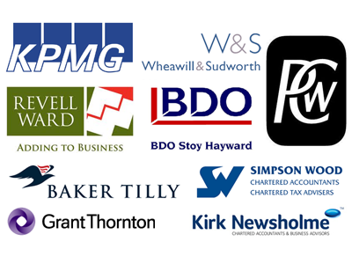
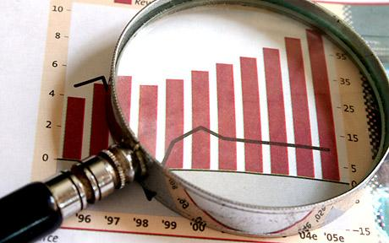
Economics A
A - Level Edexcel
General Course Information
If you have enquiring mind and are curious about the world around you, then Economics can satisfy your curiosity. It helps you to explain the big questions affecting individuals, businesses, governments and countries. For instance, is a professional footballer working for five weeks really worth the same as a nurse that has worked for forty years? Why are diamonds more expensive than water? Does our well-being in England really depend on people in other parts of the world being poor?
Economics enables you to become a critical thinker and help you to understand the world better. Why are we in a recession? How could we solve the problem of unemployment? You will learn to apply the Economists toolkit to understand and explain the world as it is and make predictions about the future direction and possible solutions.
Economics is held in high esteem by ALL the Universities, including the Russell Group, due to its academic rigour.
The A-Level is structured into four coherent themes to support teaching and learning: Theme 1: Markets and Market Failure, Theme 2: UK economy – Performance and Policies , Theme 3:Business Behaviour and the Labour Market, and Theme 4: Global Perspective.
How is the course assessed?
There are three externally assessed papers at A-Level. Each paper comprises 100 marks and is two hours in duration. Questions range from short answer (including multiple choice), data response and extended open response.
Who’s it for?
The minimum requirement is five grade 5’s, two of which should be Mathematics and English. Previous knowledge of the subject is not needed but if it has been studied a minimum of a grade 5 is required.
You will need a positive attitude and a commitment to hard work and be willing to research around concepts covered in class. Economics students will be numerate and acquire skills in research, communication, team working, analysis, decision making and problem solving.
Progression
Economics is an established academic subject and, as such, provides an excellent base for progression into higher education. Economists are highly sought after – in fact economists are the second most highly paid graduates. Those who have a good understanding of Economics will find rewarding occupations in finance, banking and management. The government and large international businesses are important employers of professional economists. You could take this course with other advanced level courses to prepare for higher education in areas of Economics, Business Studies, Accounting, Marketing or more general higher education courses. With further training, you could go into a job related to economics, business, marketing, finance and accounting, human resources and public relations. You could also look at doing a trainee management course within a business to gain the skills, understanding and experience that they require so you can progress to working at management level.

