Slide 1


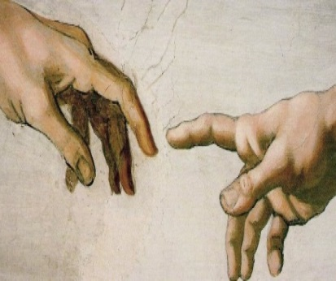

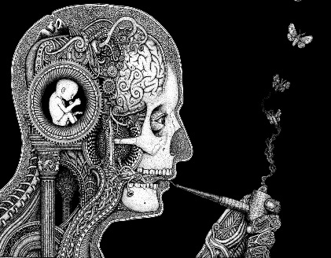
Religious Studies
A - Level OCR
“The unexamined life is not worth living” - Socrates
General Course Information
Ever since humans started to think, religion and philosophy have been a fundamental part of our development. In the 21st century, religion continues to address the same eternal human questions about life and death, values and relationships, right and wrong. An A level in Religious Studies will develop your understanding and appreciation of religious beliefs and teachings, as well as the disciplines of ethics and the philosophy of religion.
What career could A level RS lead to?
In the world of work, this is a great subject to take because it develops employability skills which all employers are seeking: researching and problem solving skills, self-management and team working skills, and communication skills. Understanding the beliefs and values of others is useful in lots of careers - working with people e.g. doctor, solicitor, dentist, social worker, police officer, nursing, council work, human resources manager etc., or in jobs requiring specialist knowledge e.g. teaching, journalism, television and the media, museum work, librarian, or even jobs in business e.g. marketing, advertising, public relations, architect etc.
How will I be assessed?
There is no coursework for this course. The final exam will be three written papers sat at the end of Year 13. The final exams will cover the following areas:-
•Philosophy of religion
ancient philosophical influences
• the nature of the soul, mind and body
• arguments about the existence or non-existence of God
• the nature and impact of religious experience
• the challenge for religious belief of the problem of evil
• ideas about the nature of God
• issues in religious language.
•Religion and ethics
•Ethical theories such as Utilitarianism (• euthanasia
business ethics
ethical language and thought
• debates surrounding the idea of conscience
• sexual ethics and the influence on ethical thought of developments in religious beliefs.
•Developments in religious thought (Focusing on Christianity)
• religious beliefs, values and teachings, their connections and how they vary historically and in the contemporary world
• sources of religious wisdom and authority
• practices which shape and express religious identity, and how these vary within a tradition • significant social and historical developments in theology and religious thought
• The relationship between religion and society
Will I enjoy it?
Religious Studies is an inclusive subject, designed for people of any faith and no faith.
If you would like to sharpen your analytical skills and try to answer the most fundamental questions you should really enjoy Religious Studies. This course is intellectually challenging and stimulating. It involves hard work, lively discussions and essay writing, as well as conferences and visiting speakers. Religious Studies A level is really worth considering and makes an excellent combination with arts, humanities and science subjects.
See Mrs Jones or your RS teacher for further information.
ljones@tcolc.aspirelp.uk
More information on the website: https://www.ocr.org.uk/qualifications/as-and-a-level/religious-studies-h173-h573-from-2016/

